Slide 1
Complexity, Modules, & Packages
W200 Computing for Data Science
Week 06
updated feb 02, 2020

Slide 2
Agenda
About HW 6 - Scrabble
Feedback at mid-point in the course https://course-evaluations.berkeley.edu
Complexity (slides 3-13)
Packages & Modules
Standard Libraries + other useful libraries
Project 1 discussion
Notes from HW4 - harder than earlier ones
Avoid nested for loops because this becomes untenable with a large # of iterations. Embedding 3 for loops? Find a better solution!
Mark’s Swiss Chalet

Slide 3
Complexity: worst-case scenarios
def fact(n):
product = 1
for i in range(n):
product = product * (i + 1)
return product
print(fact(5)
Inside fact() var product is initialized to 1. The loop executes from 1 to N and during each iteration, the product value is multiplied and stored in the product variable again.
def fact2(n):
if n == 0:
return 1
else:
return n * fact2(n - 1)
print(fact2(5))
Which algorithm is “better” [meaning faster in the worst case].
%timeit fact(50)
%timeit fact2(50)

Slide 4
Types of measurement: Big O
Constant
Linear
Quadratic
Cubic
Exponential
Logarithmic
Log Linear
O(c)
O(n)
O(n^2)
O(n^3)
O(2^n)
O(log(n))
O(nlog(n))
O(c))
Algorithm complexity is “constant” if the steps required to complete an algorithm remains constant, regardless of the number of inputs.
def constantA(items):
result = items[0] * items[0]
print()
constantA([4, 5, 6, 7])
Regardless of the # of items in the list, the algorithm performs only 2 steps: finding the square of the first element and printing on the screen.

Slide 5
Types of measurement: Big O
Constant
Linear
Quadratic
Cubic
Exponential
Logarithmic
Log Linear
O(c)
O(n)
O(n^2)
O(n^3)
O(2^n)
O(log(n))
O(nlog(n))
O(n)
The complexity of an algorithm is said to be linear if the steps required to complete the execution of an algorithm increase or decrease linearly with the number of inputs. Linear complexity is denoted by O(n).
def linear_algo(items):
for item in items:
print(item)
linear_algo([4, 5, 6, 8])
The complexity of the linear_algo function is linear in the above example since the number of iterations of the for-loop will be equal to the size of the input items array. For instance, if there are 4 items in the items list, the for-loop will be executed 4 times, and so on.

Slide 6
Types of measurement: Big O
Constant
Linear
Quadratic
Cubic
Exponential
Logarithmic
Log Linear
O(c)
O(n)
O(n^2)
O(n^3)
O(2^n)
O(log(n))
O(nlog(n))
O(n^2))
The complexity of an algorithm is said to be quadratic when the steps required to execute an algorithm are a quadratic function of the number of items in the input. Quadratic complexity is denoted as O(n^2). Take a look at the following example to see a function with quadratic complexity:
def quad(items):
for item in items:
for item2 in items:
print(item, ‘ ‘, item)
quad([4, 5, 6, 7])
In the script above, you can see that we have an outer loop that iterates through all the items in the input list and then a nested inner loop, which again iterates through all the items in the input list. The total number of steps performed is n * n, where n is the number of items in the input array

Slide 7

Complexity of functions
def demo(items):
for i in range(5):
print(“Buffalo Bills”)
for item in items:
print(item)
for item in items:
print(item)
print(“Beetlejuice”)
print(“Beetlejuice”)
print(“Beetlejuice“)
def([4, 5, 6, 7])
O(5) since 5 constant steps
O(n)
O(n)
O(3)
O(5) + O(n) + O(n) + O(3)
O(8) + O(2n)

Slide 8
Worst versus Best Case Complexity
In the script above, we have a function that takes a number and a list of numbers as input. It returns true if the passed number is found in the list of numbers, otherwise it returns false. If you search 2 in the list, it will be found in the first comparison. This is the best case complexity of the algorithm that the searched item is found in the first searched index. The best case complexity, in this case, is O(1). On the other hand, if you search 10, it will be found at the last searched index. The algorithm will have to search through all the items in the list, hence the worst case complexity becomes O(n).
def test(num, items):
for item in items:
if item == num:
return True
else:
return False
mums = [2, 3, 4, 5, 6]
print(test(2, nums)
Big O
Big Θ
Big Ω

Slide 9
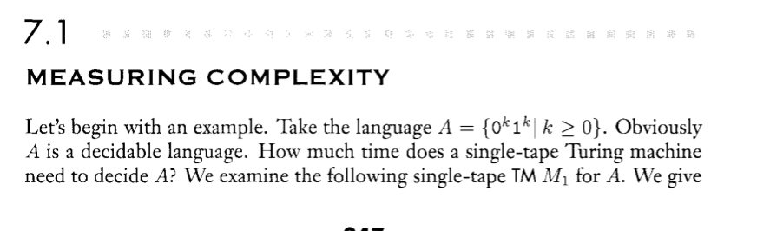
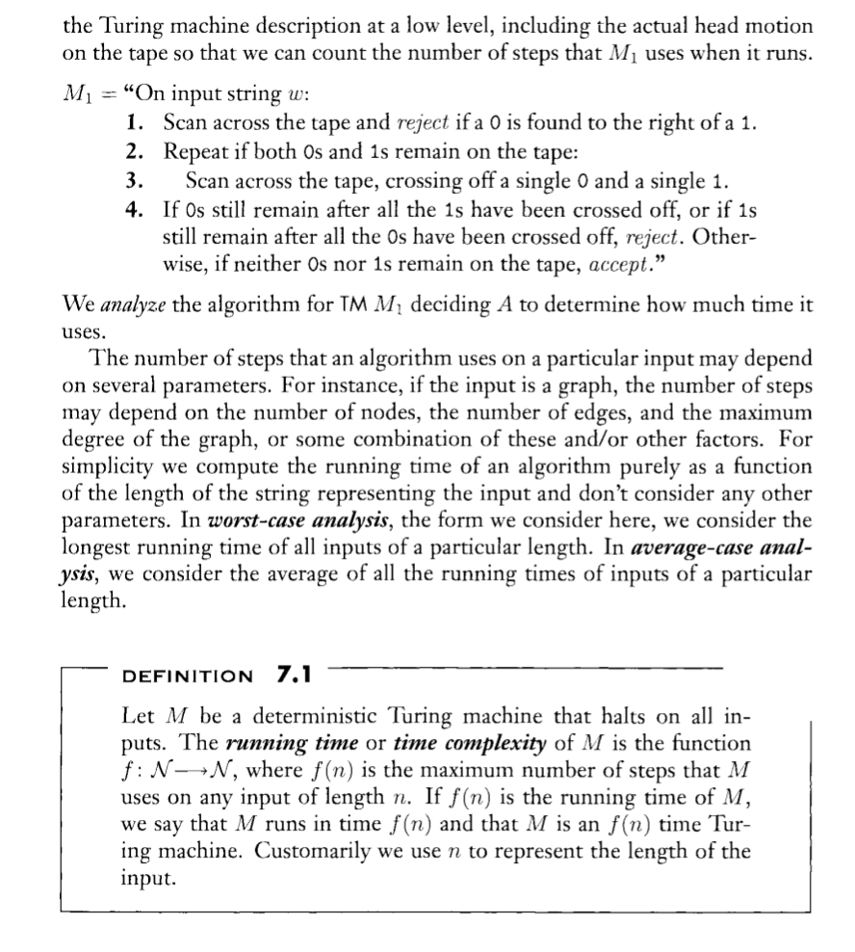
Big O & Complexity Readings
In resources folder, see BigO-2a.pdf
Sipser, Part 3
Complexity differences graph

Slide 10
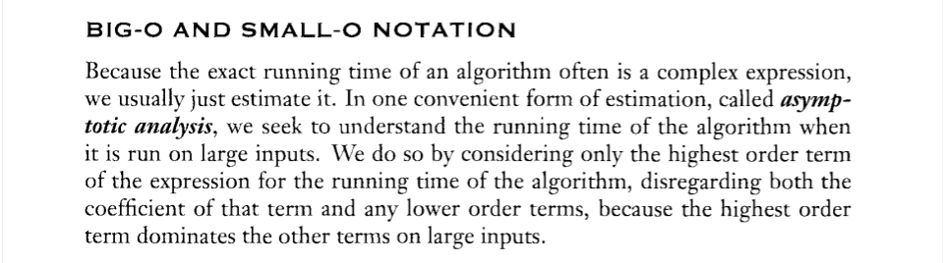
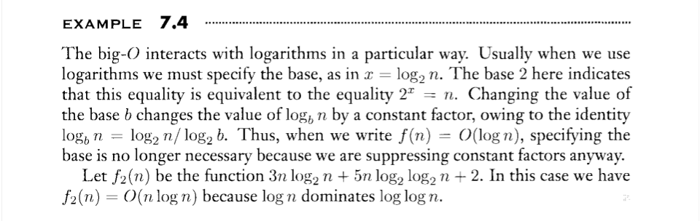
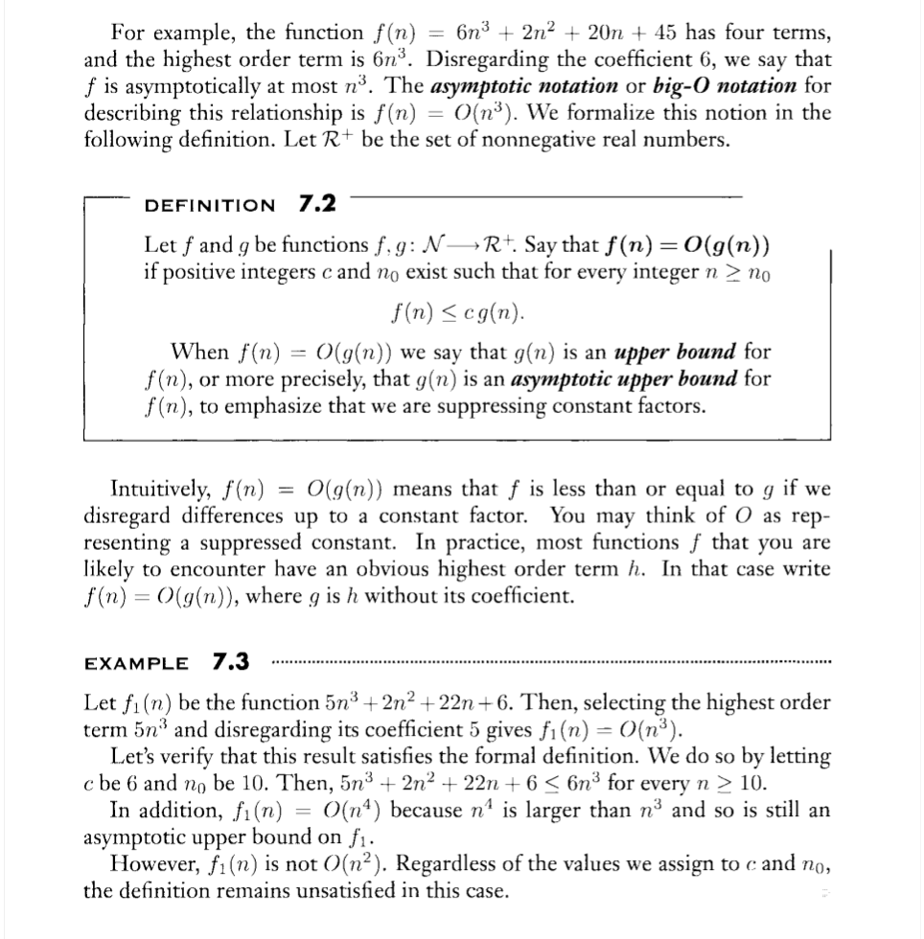
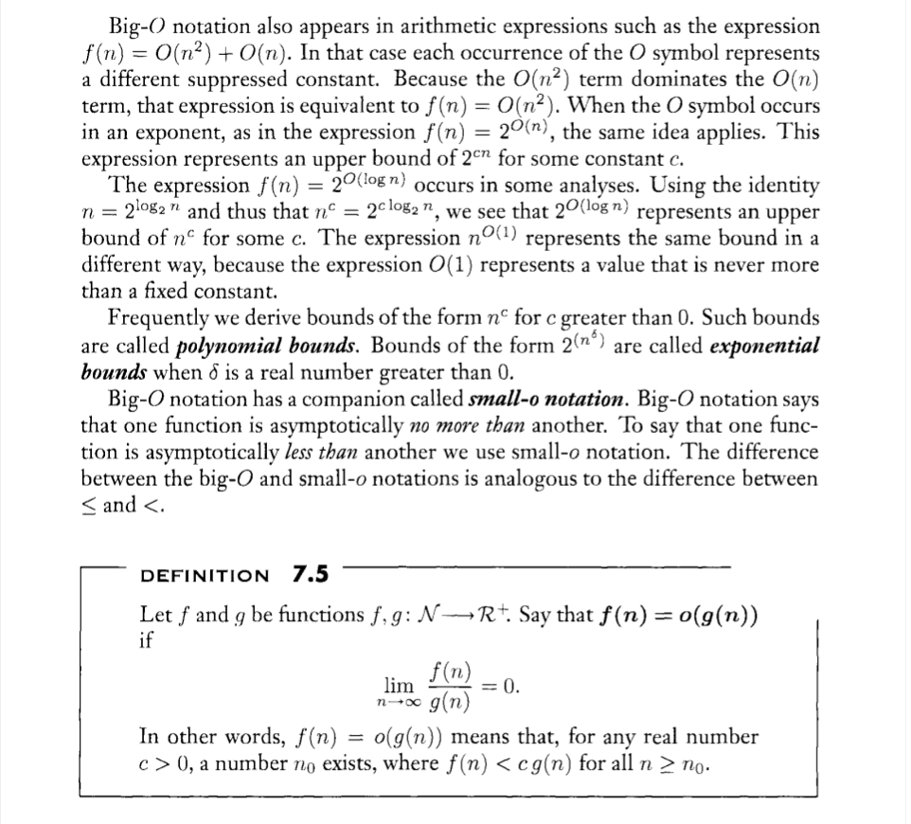
from Sipser

Slide 11
Consider this search
For looking up a given entry in a given ordered list, both the binary and the linear search algorithm (which ignores ordering) can be used. The analysis of the former and the latter algorithm shows that it takes at most log2(n) and n check steps, respectively, for a list of length n. In the depicted example list of length 33, searching for "Morin, Arthur" takes 5 and 28 steps with binary (shown in cyan) and linear (magenta) search, respectively.
By Jochen Burghardt - Own work, CC BY-SA 4.0, https://commons.wikimedia.org/w/index.php?curid=59171718

Slide 12

There are multiple standard
complexity “measures”
O(1)
O(n)
O(log(n))
O(nlog(n))
O(log(n²))
Check out wolframalpha.com for charting the difference in complexity models.
E.g., xlog(x) from 1 to 100
http://www.wolframalpha.com/input/?i=plot+xlog(x)+from+1+to+100
http://www.wolframalpha.com/input/?i=plot+log(x)+from+1+to+100
Don’t stress over O(n) …

Slide 13
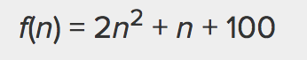
Rules to simplify - understand the growth rate
Think in terms of worst case scenario
Remove lower order terms (n and 100)
Those that do not scale or scale at lower rates
Remove constants (2)
Not reliable when considering hardware and elementary steps
Can always refine the algorithm to reduce the constant

Slide 14
Import Statement
Some examples. Do you see any problems?
import sys
call using sys.argv
from sys import args as args
call using “argv”
import sys as s
call with s.argv
import sys.argv as s
call as s

Slide 15

Packets & Modules
Definitions:
Module: a .py file with related functions
Package: a folder of related modules
Import: import packages and modules or parts of modules with “import” or “from xxx import yyy”
How we import a module affects references to the code later in our code …
com
Tangent: some imports are bound to actual file locations.
jdbcodbc
com.jdbcodbc.sql
sql

Slide 16
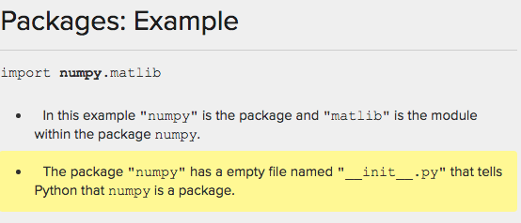
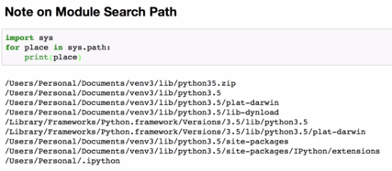
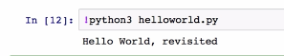
Packets & Modules
1
2
We can import the whole package
import numpy
First in current directory
Then down the sys.path list
You can modify the search path with sys.path.append()
3
import sys
for place in sys.path:
print(place)
4
Tangent: not uncommon to
have a full library
and a “minimum” version,
e.g., d3-min.js versus d3.js
Run the help() command to see functions in a package
! to invoke the command line in ipynb
You can run or “cat” codes to print them directly

Slide 17
Activity: wraps & piggy
Enjoy this week’s activity …
after activity: Libraries:
collections.counter()
date time
web scraping

Slide 18
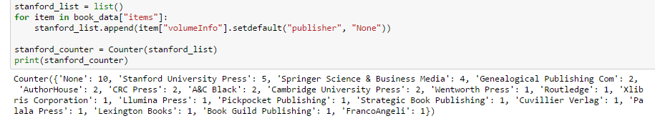
Standard Libraries in Python
why for loop when you can collection/counter()?!
Quickly create a counting dictionary by passing in a list 1) Makes list 2) Passes into counter()
Operations on counters
MyCounterObj.most_common()
Add, subtract, I (or), &
see also: counter1.py

Slide 19
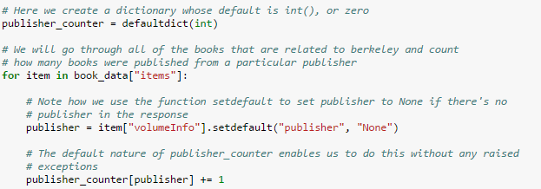
Standard libraries: default values
Avoid key errors by using defaults. Two flavors of defaults:
Regular dictionary: dictionary_name.setdefault(KEY, VALUE)
DefaultDict: collections.defaultdict(defaultvalue) #default is a function, an int, empty list …
For this example …
Initialize defaultdict to product an int if there is no value
For each volume, use setdefault to get the publisher or “none” as the key
Increment the publisher count as the value.

Slide 20
import re
import string
frequency = {}
document_text = open("testfile.txt", "r")
text_string = document_text.read().lower()
match_pattern = re.findall(r'\b[a-z]{3,15}\b', text_string)
for word in match_pattern:
count = frequency.get(word,0)
frequency[word] = count + 1
frequency_list = frequency.keys()
for words in frequency_list:
print(words, frequency[words])
print("-"*60)
print("\n All done! \n")
print("-"*60)

Slide 21
Standard Library, example
collections.deque()
collections.OrderedDict() # for ordered streams, etc.
pop() # from left … can take (int)
popleft()
pip install() # terminal cmd for installing …
Virtualenv() # e.g., conda env create

Slide 22
Standard Libraries: datetime
Date object has lots of specific details we need for int’l and keeping data in LILO order.
Timezone, Calendars, Time Deltas, UTC offset, DateTime object (for timestamp).
Converting date object to desired output (strftime)
Use ptyz package for daylight savings issues.
object
timedelta
tzinfo
timezone
time
date
datetime
https://docs.python.org/3/library/datetime.html
see the “forecast.py” file

Slide 23
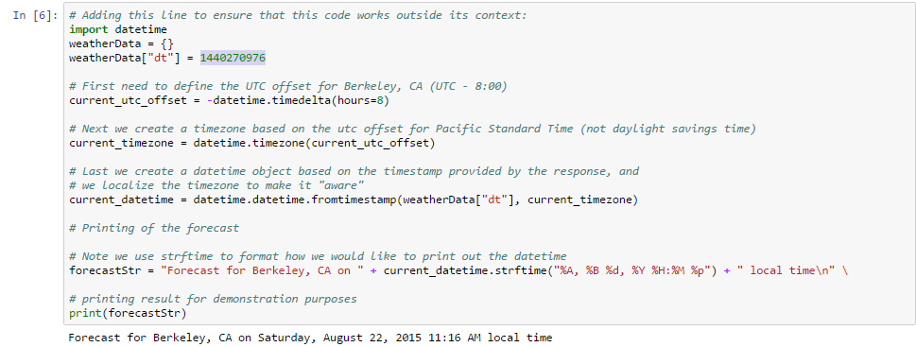
Standard Libraries: DateTime example

Slide 24
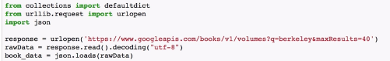
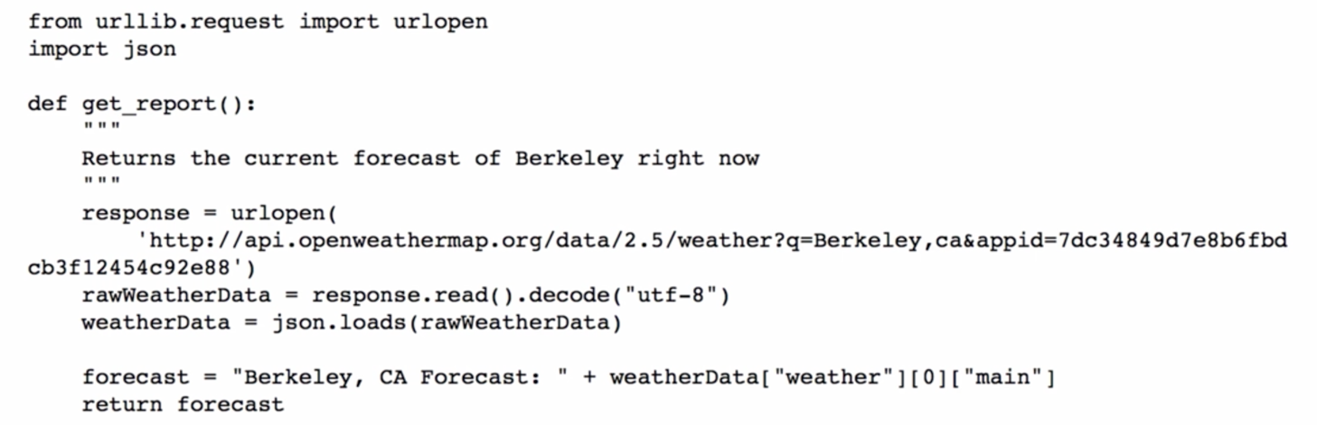
Web Scraping
Import collections
Enable communicating over the Net
import json to read .json files
Note! On the Net we send data between client/server via a Request Object. The server responds by sending back a Response Object.
We need to create a bridge between client + server (the urlopen() command) that sends/receives the objects. Then we open the object (not unlike getting a letter from an envelope). We have to know what to send and how to interpret the result (hence the various APIs). Pretty much can’t go wrong with .json
Yes, there are other libraries for scraping: requests, beautiful soup 4, lxml, selenium, scrapy
https://elitedatascience.com/python-web-scraping-libraries

Slide 25
Web scraping & planning ahead
We want to emphasize data - data streams can be large or small; static or dynamic.
Very large datasets overwhelm RAM … these require either chunking our data (aggregating smaller chunks for clustering & classifying data) or considering a data science Information Ecology, such as Hadoop.
As data are unknown - we’ll have to “clean” them - looking for null values, missing, out-of-range, etc. With so many things possible, let’s modularize … perhaps as objects? (grin)

Slide 26
Project 1: Data Oriented Design
No limit to your ideas - work- or home- or other life-related!
Objects are supposed to reflect things-in-the-real-world
Project code: 300-500 lines (no more than 750 please)
Lots of comments should be in the code.
Demonstrate objects, various control-of-flow and data types.
Be robust to errors and exceptions.

Slide 27
Summary
Robert Reich - check him out
algorithm performance is measured in its worst-case performance.
libraries of helpful code are in modules, packages; we include them in our own .py files through the import statement
Folder structure and module location are tightly associate
standard libraries: there’s the “hard-way” and then libraries, like Counter, that do the heavy lifting. If jupyter or python3 runs without a question - then the library is standard.
web scraping is useful, popular; intros idea of Request/Response object.
project 1 is where you shine with object-oriented design/programming.

Slide 28
extras.

Slide 29
https://doc.scrapy.org/en/latest/topics/architecture.html

